Slide 1
Argumentation framework
Student: Ștefan Drăgoi
Coordinator: Lect. Dr. Andrei Cristian Frăsinaru

Slide 2
Agenda
Abstract Argumentation Framework
Algorithm
Benchmarking
Demo

Slide 3
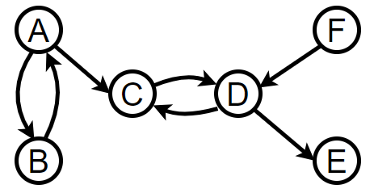

Abstract Argumentation Framework
An argumentation framework is a pair:
AF = <A, R>
A – a set of arguments
R – binary relation on A (attacks $⊆$ AR x AR). [1]
A = {A, B, C, D, E, F}
R = {(A, B), (B, A), (A, C), (D, C), …}

Slide 4
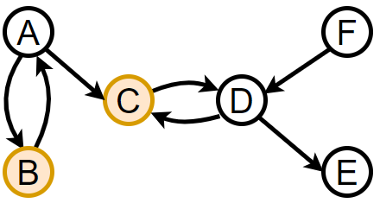
Abstract Argumentation Framework
Conflict-free sets: {B, C},

Slide 5
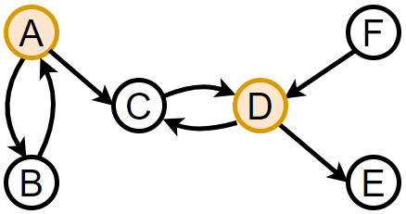
Abstract Argumentation Framework
Conflict-free sets: {B, C}, {A, D},

Slide 6
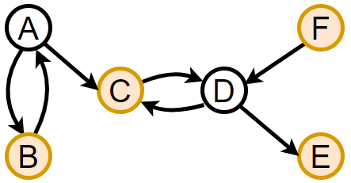
Abstract Argumentation Framework
Conflict-free sets: {B, C}, {A, D}, {B, C, E, F};

Slide 7
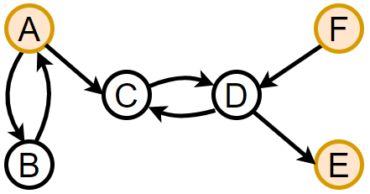
Abstract Argumentation Framework
Conflict-free sets: {B, C}, {A, D}, {B, C, E, F};
Stable extensions: {A, E, F};

Slide 8
Abstract Argumentation Framework
Conflict-free sets: {B, C}, {A, D}, {B, C, E, F};
Stable extensions: {A, E, F};
Admissible: {B, C, E, F},

Slide 9
Abstract Argumentation Framework
Conflict-free sets: {B, C}, {A, D}, {B, C, E, F};
Stable extensions: {A, E, F};
Admissible: {B, C, E, F}, {A, E, F},

Slide 10
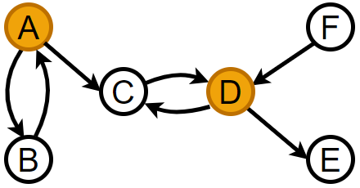
Abstract Argumentation Framework
Conflict-free sets: {B, C}, {A, D}, {B, C, E, F};
Stable extensions: {A, E, F};
Admissible: {B, C, E, F}, {A, E, F}, {A, D};

Slide 11
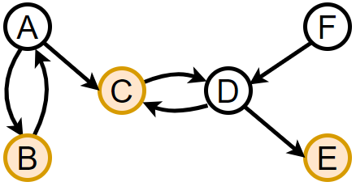
Abstract Argumentation Framework
Conflict-free sets: {B, C}, {A, D}, {B, C, E, F};
Stable extensions: {A, E, F};
Admissible: {B, C, E, F}, {A, E, F}, {A, D};
Complete: {B, C, E},

Slide 12
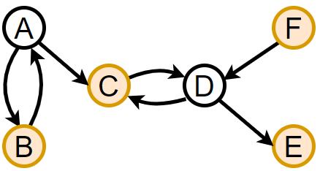
Abstract Argumentation Framework
Conflict-free sets: {B, C}, {A, D}, {B, C, E, F};
Stable extensions: {A, E, F};
Admissible: {B, C, E, F}, {A, E, F}, {A, D};
Complete: {B, C, E}, {B, C, E, F};

Slide 13
Abstract Argumentation Framework
Conflict-free sets: {B, C}, {A, D}, {B, C, E, F};
Stable extensions: {A, E, F};
Admissible: {B, C, E, F}, {A, E, F}, {A, D};
Complete: {B, C, E}, {B, C, E, F};
Preferred: {B, C, E, F};

Slide 14
Abstract Argumentation Framework
Conflict-free sets: {B, C}, {A, D}, {B, C, E, F};
Stable extensions: {A, E, F};
Admissible: {B, C, E, F}, {A, E, F}, {A, D};
Complete: {B, C, E}, {B, C, E, F};
Preferred: {B, C, E, F};
Grounded: {B, C, E};

Slide 15
Algorithm
Implemented in Java using Choco-solver constraint library;
Approached the problem as a Constraint Satisfaction Problem (CSP);
Expressed Argumentation framework’s properties as Propositional Logic;
Transposed the resulted propositions in Choco-solver constraints;

Slide 16

Algorithm
An argumentation framework property is represented as a tuple (S, D, C):
Conflict-free extension
A set S of arguments is conflict-free if arguments of the set do not attack each other:
C = { a$⇒¬b$ | (a, b) $ε R$ }
Stable extension
A set S of arguments is stable if is conflict-free && arguments of S attack all $args∉S$:
C = { $a⇔\bigwedge_{b:(b, a)∈R}{¬b} | a ε A$}
S = A (arguments) | $D_{i}=\{0, 1\}$ | C = constraint

Slide 17

Benchmarking
 | Our device | Their device
Processor | Intel i7-11850H, 2.50 GHz | Intel i7-970, 3.20 GHz
RAM | 16 GB | 16 GB
ASPARTIX – ICCMA 2015, 2019, 2021
ConArg2 – ICCMA 2015, 2017, 2021
Source: https://conarg.dmi.unipg.it
 |  |  |  | Kleinberg |  |  |  |  |  | Erdős–Rényi
 |  |  |  | 25 |  | 36 |  | 49 |  | 100 |  | 200 |  | 300
 |  | Our algorithm |  | 0.10 |  | 0.12 |  | 0.15 |  | 0.25 |  | 6.63 |  | 129.26
admissible |  | ASPARTIX |  | 0.08 |  | 2.57 |  | 157.00 |  | 0.98 |  | 81.30 |  | 96.40
 |  | ConArg2 |  | 0.01 |  | 0.13 |  | 8.43 |  | 0.05 |  | 13.30 |  | 11.00
 |  | Our algorithm |  | 0.10 |  | 0.13 |  | 0.17 |  | 0.29 |  | 7.28 |  | 116.18
complete |  | ASPARTIX |  | 0.03 |  | 0.67 |  | 20.90 |  | 0.02 |  | 1.69 |  | 83.50
 |  | ConArg2 |  | 0.01 |  | 0.06 |  | 1.59 |  | 0.01 |  | 0.73 |  | 68.70
 |  | Our algorithm |  | 0.01 |  | 0.03 |  | 0.03 |  | 0.01 |  | 0.20 |  | 65.18
stable |  | ASPARTIX |  | 0.01 |  | 0.05 |  | 0.54 |  | 0.01 |  | 0.22 |  | 11.32
 |  | ConArg2 |  | 0.01 |  | 0.01 |  | 0.04 |  | 0.01 |  | 0.09 |  | 5.88
 |  | Our algorithm |  | 0.09 |  | 0.12 |  | 0.17 |  | 0.27 |  | 7.73 |  | 111.98
preferred |  | ASPARTIX |  | 0.35 |  | 4.67 |  | 85.20 |  | 0.33 |  | 0.99 |  | 3.04
 |  | ConArg2 |  | 0.04 |  | 1.96 |  | 230.00 |  | 0.04 |  | 4.53 |  | 117.00
 |  | Our algorithm |  | 0.12 |  | 0.17 |  | 0.16 |  | 0.29 |  | 6.94 |  | 121.26
grounded |  | ASPARTIX |  | 0.44 |  | 9.48 |  | 39.10 |  | 0.16 |  | 1.16 |  | 3.92
 |  | ConArg2 |  | 0.19 |  | 0.07 |  | 0.11 |  | 0.01 |  | 0.90 |  | 75.90

Slide 18

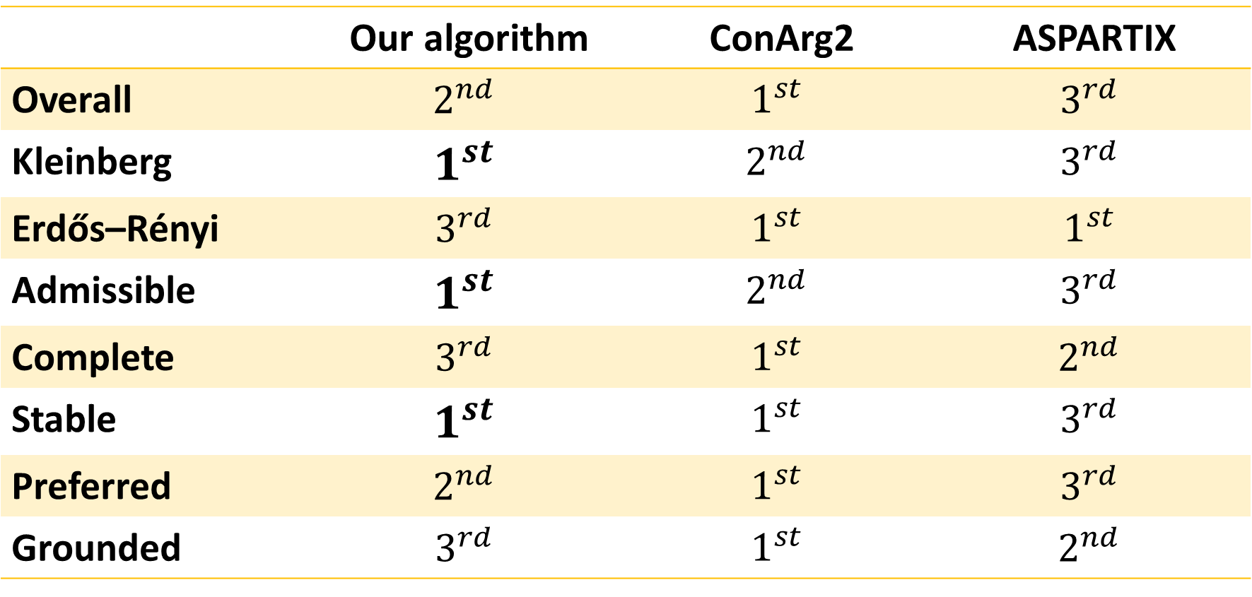
Benchmarking results
 | Our device | Their device
Processor | Intel i7-11850H, 2.50 GHz | Intel i7-970, 3.20 GHz
RAM | 16 GB | 16 GB
 | Our algorithm | ConArg2 | ASPARTIX
Overall | $$2^{nd}$$ | $$1^{st}$$ | $$3^{rd}$$
Kleinberg | $$1^{st}$$ | $$2^{nd}$$ | $$3^{rd}$$
Erdős–Rényi | $$3^{rd}$$ | $$1^{st}$$ | $$1^{st}$$
Admissible | $$1^{st}$$ | $$2^{nd}$$ | $$3^{rd}$$
Complete | $$3^{rd}$$ | $$1^{st}$$ | $$2^{nd}$$
Stable | $$1^{st}$$ | $$1^{st}$$ | $$3^{rd}$$
Preferred | $$2^{nd}$$ | $$1^{st}$$ | $$3^{rd}$$
Grounded | $$3^{rd}$$ | $$1^{st}$$ | $$2^{nd}$$

Slide 19
Demo

Slide 20
Thank you!

Slide 21
Bibliography
[1] On the acceptability of arguments and its fundamental role in nonmonotonic reasoning, logic programming and n-person games, Phan Minh Dung, 1995
[2] Argumentation Frameworks as Constraint Satisfaction Problems, Leila Amgoud, Caroline Devred
[3] A Basic Framework for Explanations in Argumentation, AnneMarie Borg, Floris Bex
[4] An introduction to argumentation semantics, Pietri Baroni, Martin Caminada, Massimiliano Giacomin

